Slide 1

Examination Attendance System using Face Recognition
(Proposal)
NAME : Nontsikelelo Mamba
STUDENT ID : 201580047
DEPARTMENT : Computer Science
SUPERVISOR : Mr. L. Sithole

Slide 2
Outline
INTRODUCTION
AIMS AND OBJECTIVES
PROPOSED SYSTEM
METHODOLOGY
System data flow chart
ETHICS
SUMMARY
REFERENCES

Slide 3
INTRODUCTION
An examination attendance system is an automatic technique that identifies and marks the attendance of students.
The purpose of this study is to eliminate the convectional method for examination room attendance and apply the proposed system of authentication using face recognition.
The Examination Attendance System has four main modules.
Face detection
Feature extraction
Face Recognition
Attendance update on database
Notes:
Face detection: find the area that contains the face
Feature extraction: finding unique characteristic features of a face useful for face recognition
face recognition: recognizes the face and matches it to that of a student found in the database

Slide 4
CONT..
The exam attendance in the institution is done manually using the old paper or file-based approach.
The students have to wait for long time standing in queues in order to enter the examination room.
This exam attendance system using face recognition will handle all the current issues faced by the students and the invigilators.
Loss of Data
Time Wasting
Tedious
Security
Notes:
Loss of Data: A lot of paper works are needed for the safe keeping of the details of the students registered for the exam sitting.
Time Wasting: extra work for the invigilators to mark rollcall
Tedious: the data retrieval speed is very slow as it is done manually and not automated
Security: there is no guarantee of security to the data about the student

Slide 5
AIMS AND OBJECTIVES
Aim
Developing an exam attendance system that can manage, recognize registered students and marking attendance in a reliable and efficient way.
Objectives
Detection of faces amongst other face characters
Extraction of unique characteristic features of a face useful for face recognition.
Recognition of a face available in the database
Automated update in the database without human intervention.
Provide accurate information

Slide 6
PROPOSED SYSTEM
Proposed system is an automated Exam attendance system.
It will be developed using Python programming language and the database PHP(front-end) MySQL(back-end).
System can be used in Windows and Linux platforms
Advantages
Fast access to database
Less errors
Time saving
Adequate data security
Automatic attendance registration

Slide 7
METHODOLOGY
The proposed system utilized the following algorithms for face recognition:
Face detection :Haar Cascade algorithm
Feature extraction: Eigenfaces
Classification: K-NN algorithm
Dataset: PUT database + students dataset
Notes:
Haar: collecting haar features(adjacent rectangular regions at specific locations in detection window) summing up pixel intensity of each region and calculate diff btwn these sums.
Eigen: image projected into low dimensional space learned through the principle component analysis by extracting features, in which a small set of characteristic features
are used to describe the variations between face images
KNN algo- purpose is to use a database in which the face features are seperated into several classes to predict the classification of a new face,object assigned to the class with its most k nearest neighbour. Face claasified based on training set.
Database of faces: contains of a set of images taken at diffent times varying lighting, facial expression and facial details. Taken against a homogenous background subject in upright frontal position.

Slide 8
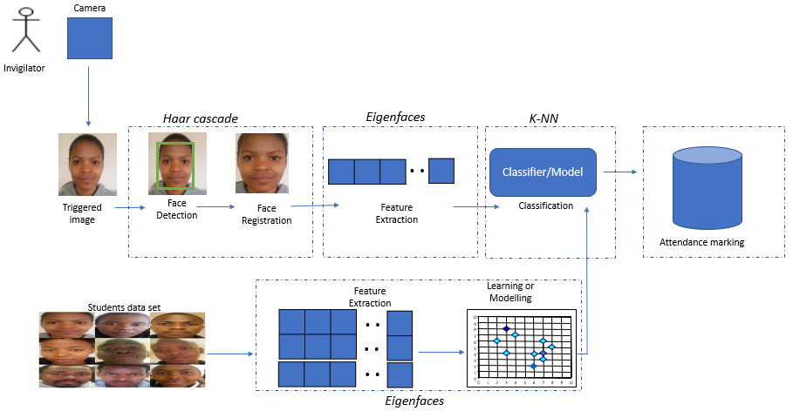
System data flow chart

Slide 9
ETHICS
Collection: The institution must receive informed, written, and specific consent from students before enrolling them in a face recognition database.
Use.: An entity must receive informed, written consent from an individual before using a facial recognition system or faceprint in a manner not covered by existing consent.
Sharing: A faceprint or any information derived from the operation of a face recognition system may not be sold or shared except with the informed, written consent of the individual whose information is being sold or shared
Access: An authorized individual must have the right to access, correct, and delete the faceprint information.

Slide 10
SUMMARY
In this proposed examination attendance system invigilators can record student’s attendance, saving time and effort since the number of students is huge.
The system combines face detection, feature extraction to recognize the student and update attendance of every student in the database
It will replace the paper based existing method of attendance marking.
Notes:
What?
How?
Why?

Slide 11
REFERENCES
Ashish Choudhary, A. T. (2016). Automatic Attendance System Using Face Recognition. International Journal of Modern Trends in Engineeringa and Research, 363-364.
CAO WeiFeng, L. B. (2015). Attendance System Applied in Classroom Based on Face Image. International Symposium on Computers & Informatics, pg 1631.
Chaitanya P, S. B. (n.d.). Automatic Student Attendence System Using Face Recognition.
Jones, P. V. (2001). Rapid object detection using a boosted cascade of simple features in Computer Vision and Pattern Recognition. Proceedings of the 2001 IEEE Computer Society Conference, 511-518.
Sai, V. m., Varalakshmi, G., Kumar, B. G., & Prasad, J. (2017). Face Recognition System With Face Detection. Pace Institute of Technology & Sciences, 1-55.
Selvi, K. P. (2014). Face Recognition Based Attendence Marking System. International Journal of Computer Science and Mobile Computing, p.337-342.
Vandna Singh, D. V. (2013). Face Detection by Haar Cascade Classifier with Simple and Complex Backgrounds images using OpenCV Implementation. International Journal of Advanced Technology in Engineering and Science, 33-38.

Slide 12
Thank You!! Q&A

